Slide 1

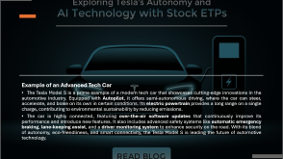
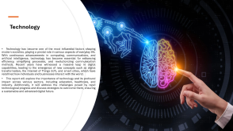
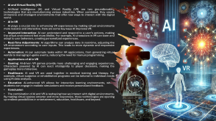
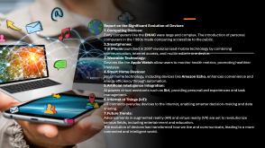

Slide 3





Slide 4
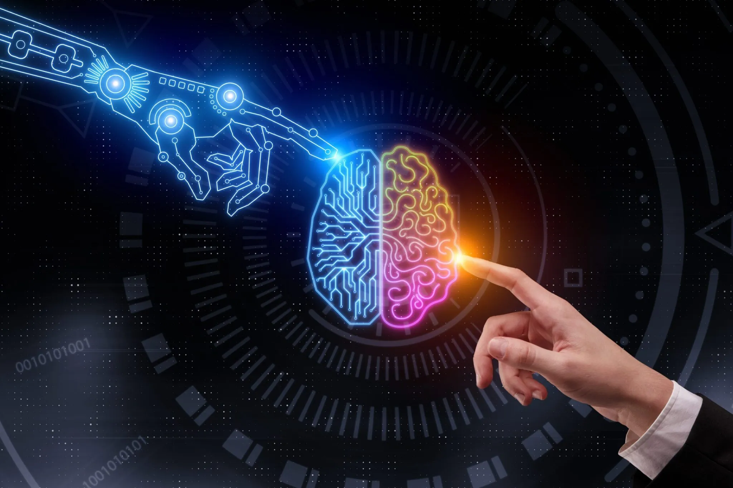
Technology
Technology has become one of the most influential factors shaping modern societies, playing a pivotal role in various aspects of everyday life. With continuous advancements in computing, communications, and artificial intelligence, technology has become essential for enhancing efficiency, simplifying processes, and revolutionizing communication methods. Recent years have witnessed a massive leap in digital capabilities, leading to the emergence of new concepts such as digital transformation, the Internet of Things (IoT), and smart cities, which have redefined how individuals and businesses interact with the world.
This report will explore the importance of technology and its profound impact across various sectors, including education, healthcare, and industry. Additionally, it will address the challenges posed by rapid technological progress and discuss strategies to overcome them, ensuring a sustainable and advanced digital future.

Slide 5

Example of an Advanced Tech Car
The Tesla Model S is a prime example of a modern tech car that showcases cutting-edge innovations in the automotive industry. Equipped with Autopilot, it offers semi-autonomous driving, where the car can steer, accelerate, and brake on its own in certain conditions. Its electric powertrain provides a long range on a single charge, contributing to environmental sustainability by reducing emissions.
The car is highly connected, featuring over-the-air software updates that continuously improve its performance and introduce new features. It also includes advanced safety systems like automatic emergency braking, lane-keeping assist, and a driver monitoring system to enhance security on the road. With its blend of autonomy, eco-friendliness, and smart connectivity, the Tesla Model S is leading the future of automotive technology.

Slide 6

Report on the Significant Evolution of Devices
Computing Devices: Early computers like the ENIAC were large and complex. The introduction of personal computers in the 1980s made computing accessible to the public.
Smartphones: The iPhone launched in 2007 revolutionized mobile technology by combining communication, internet access, and multimedia in one device.
Wearable Technology: Devices like the Apple Watch allow users to monitor health metrics, promoting healthier lifestyles.
Smart Home Devices: Smart home technology, including devices like Amazon Echo, enhances convenience and energy efficiency through automation.
Artificial Intelligence Integration: AI powers virtual assistants such as Siri, providing personalized experiences and task management.
Internet of Things (IoT): IoT connects everyday devices to the internet, enabling smarter decision-making and data sharing.
Future Trends: Advancements in augmented reality (AR) and virtual reality (VR) are set to revolutionize various fields, including entertainment and education.
The evolution of devices has transformed how we live and communicate, leading to a more connected and intelligent world.

Slide 7
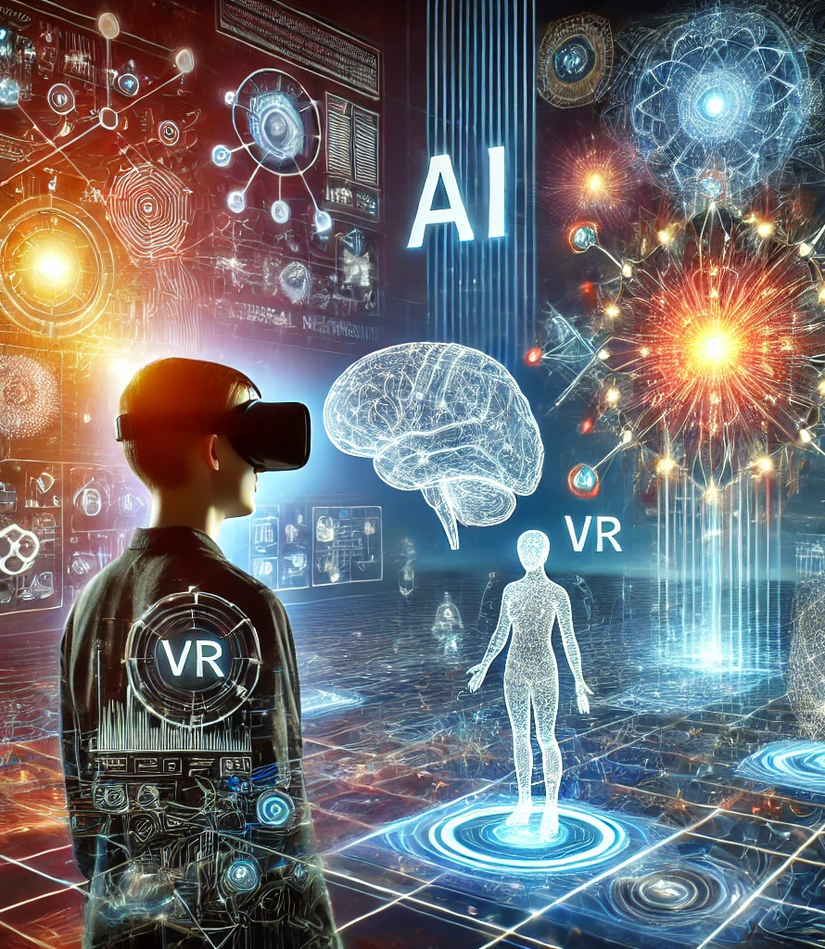
AI and Virtual Reality (VR)
Artificial Intelligence (AI) and Virtual Reality (VR) are two groundbreaking technologies that are revolutionizing various industries. When combined, they create immersive and intelligent environments that offer new ways to interact with the digital world.
AI in VR
AI plays a crucial role in enhancing VR experiences by making virtual environments more realistic and interactive. Here are some key ways AI improves VR:
Improved Interaction: AI can understand and respond to a user’s actions, making the virtual environment feel more lifelike. For example, AI characters in VR can learn and adapt to user behaviors, creating personalized experiences.
Real-Time Adjustments: AI algorithms can analyze data in real-time, adjusting the VR environment according to user inputs. This leads to more dynamic and responsive experiences.
Automation: AI can automate tasks within VR applications, from generating virtual worlds to managing in-game events, reducing the need for manual programming.
Applications of AI in VR
Gaming: AI-driven VR games provide more challenging and engaging experiences. Characters powered by AI can react intelligently to player decisions, making the gameplay more immersive.
Healthcare: AI and VR are used together in medical training and therapy. For example, virtual surgeries or rehabilitation programs can be tailored to individual needs using AI data analysis.
Education: AI-enhanced VR allows for interactive learning environments, where students can engage in realistic simulations and receive personalized feedback.
Conclusion
The combination of AI and VR is reshaping how we interact with digital environments. By making virtual spaces smarter and more responsive, these technologies are opening up endless possibilities in entertainment, education, healthcare, and beyond.

